Slide 1


Digital Data

Slide 2
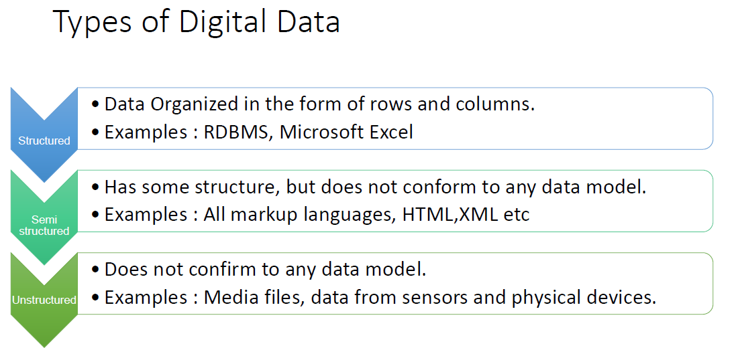

Slide 3
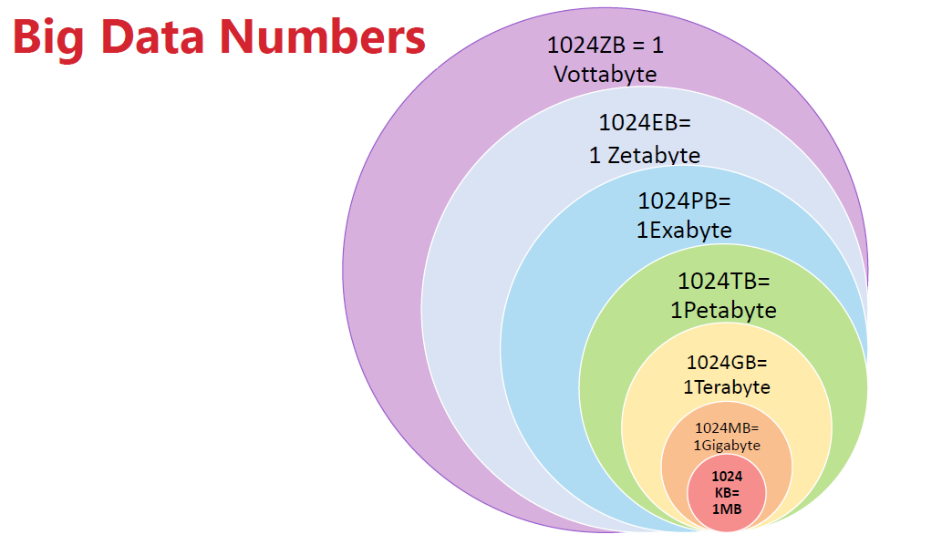

Slide 4
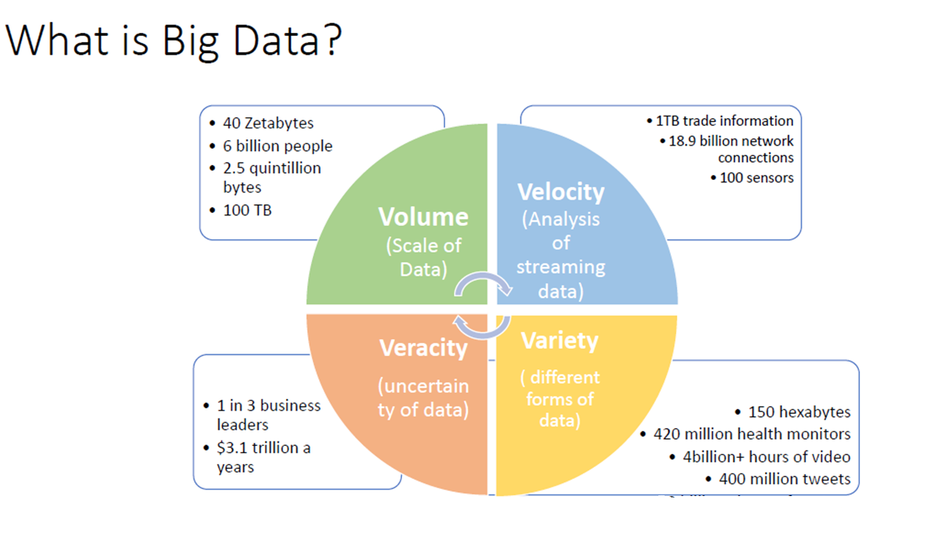

Slide 5
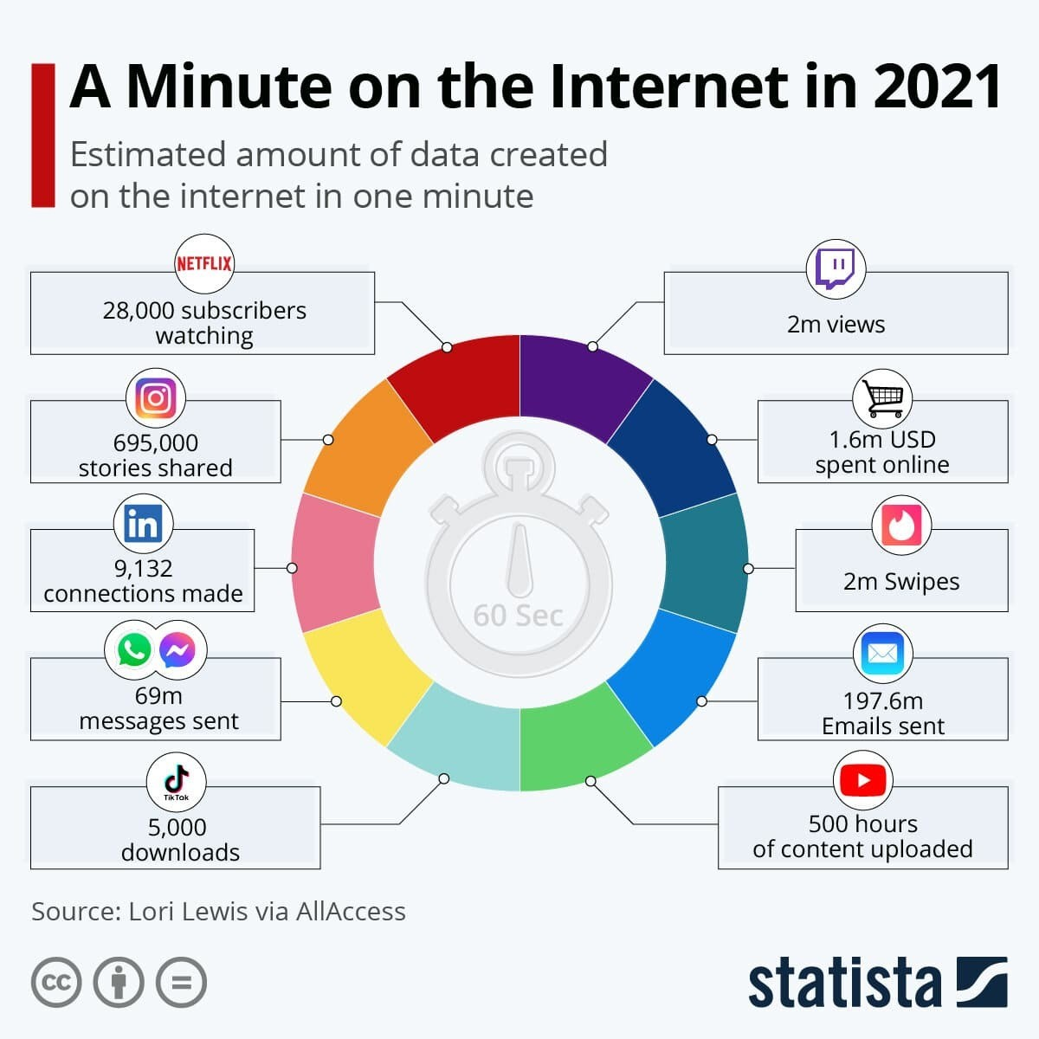
What Happens in 60 seconds over internet in 2023?
Link: https://www.weforum.org/agenda/2021/08/one-minute-internet-web-social-media-technology-online/

Slide 6
Machine Learning

Slide 7
SL No | No. of Action Scene | No. of Comedy Scene | Class/ Label/ Category
1 | 100 | 15
2 | 20 | 95
3 | 90 | 5
4 | 10 | 85
SL No | No. of Action Scene | No. of Comedy Scene | Class/ Label/ Category
1 | 100 | 15 | Action
2 | 20 | 95 | Comedy
3 | 90 | 5 | Action
4 | 10 | 85 | Comedy
5 | 50 | 50
What is the category of the movie?

Slide 8
How many groups are there?

Slide 9
k nearest neighbour

Slide 10
Train Set
SL No | No. of Action Scene | No. of Comedy Scene | Class/ Labels/ Category
T1 | 100 | 15 | Action
T2 | 20 | 95 | Comedy
T3 | 90 | 5 | Action
T4 | 10 | 85 | Comedy
Comedy
d2
d4
Test Set
(50,50)
T5 | 50 | 50 | ?
d1
Steps to be followed
Compute Euclidian Distance from val/test to all the training data points
Sort the data in the ascending order
Compute the value of k
Use the value of k to compute the classification on test data and compute the accuracy
d3
(15,125)
Action
Use Validation data to determine the value of k. Voting scheme may be used for taking the majority voting.
Compute accuracy on different values of k and choose the one with the highest accuracy
Value of k should be odd in case of binary classification

Slide 11
Step 1: Compute Euclidean Distance
Sl. No. | Distance | Train | Test | Class of Train | Distance
1 | D1 | T1 | T5 | Action | 61.03277808
2 | D2 | T2 | T5 | Comedy | 54.08326913
3 | D3 | T3 | T5 | Action | 60.20797289
4 | D4 | T4 | T5 | Comedy | 53.15072906
Step 2: Sort the data on the basis of Distance
Sl. No. | Distance | Train | Test | Class of Train | Distance
4 | D4 | T4 | T5 | Comedy | 53.1507
2 | D2 | T2 | T5 | Comedy | 54.0833
3 | D3 | T3 | T5 | Action | 60.208
1 | D1 | T1 | T5 | Action | 61.0328
Step 2: Determine the value of k
Different Values of k | Classes | Majority Vote
1 | {Comedy} | Comedy
2 | {Comedy, Comedy} | Comedy
3 | {Comedy, Comedy, Action} | Comedy

Slide 12
Dataset
80%
20%
Train + Val
OR
Train
Test
Compute the accuracy of the test set using the value of k which had the highest accuracy in validation data.
80%
20%
Train
Val
Compute Accuracy for Different Values of k using Validation Dataset, select the k with the highest accuracy

Slide 13
 | Train (50) | Test(50) | Train (60) | Test(40) | Train (70) | Test(30) | Train (80) | Test(20) | Train (99.5) | Test(0.5)
100 | 50 | 50 | 60 | 40 | 70 | 30 | 80 | 20 | 99.5 | 0.5
1000 | 500 | 500 | 600 | 400 | 700 | 300 | 800 | 200 | 995 | 5
10,000 | 5000 | 5000 | 6000 | 4000 | 7000 | 3000 | 8000 | 2000 | 9950 | 50
1,00,000 | 50000 | 50000 | 60000 | 40000 | 70000 | 30000 | 80000 | 20000 | 99500 | 500
10,00,000 | 500000 | 500000 | 600000 | 400000 | 700000 | 300000 | 800000 | 200000 | 995000 | 5000
1,00,00,000 | 5000000 | 5000000 | 6000000 | 4000000 | 7000000 | 3000000 | 8000000 | 2000000 | 9950000 | 50000

Slide 14
Naive Bayes

Slide 15






Bayesian Framework
Conditional Probability
Universal Set S
$$P\left(A | B\right)= \frac{P\text{(}\text{A}\text{∩}\text{B}\text{)} }{\text{P}\text{(}\text{B}\text{)}}$$
$$P\text{(}\text{A}\text{∩}\text{B}\text{)}= P\left(A | B\right)P(B)$$
A
B
$$P\left(B | A\right)= \frac{P\text{(}\text{B}\text{∩}\text{A}\text{)} }{\text{P}\text{(}\text{A}\text{)}}$$
$$P\text{(}\text{B}\text{∩}\text{A}\text{)}= P\left(B | A\right)P(A)$$
A ∩ B = B ∩ A
$$P\left(B | A\right)P\left(A\right)= P\left(A | B\right)P(B)$$
Naïve Bayes Equation
$$P\left(B | A\right)= \frac{P\left(A | B\right)P(B)}{P\left(A\right)}$$
A ∩ B

Slide 16


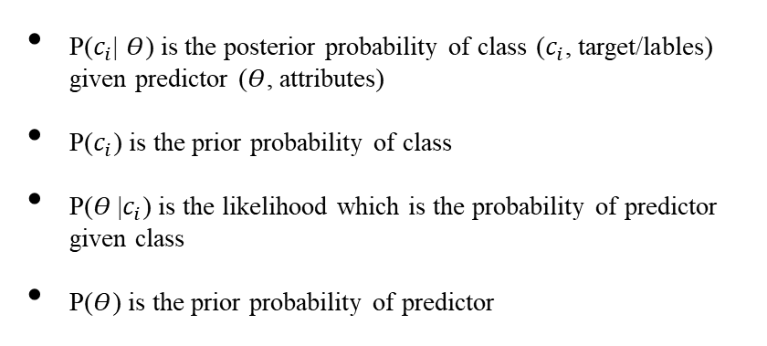


$$P\left(B | A\right)= \frac{P\left(A | B\right)P(B)}{\left(A\right)}$$
$A=\{Θ_{1},Θ_{2},Θ_{3}…Θ_{n}\}$; Set of Independent Events/Features
$$c_{i}=Labels/Targets$$
$$P\left(c_{i} | Θ_{1},Θ_{2},Θ_{3}…Θ_{n}\right)= \frac{P\left(Θ_{1},Θ_{2},Θ_{3}…Θ_{n} | c_{i}\right)P(c_{i})}{P\left(Θ_{1},Θ_{2},Θ_{3}…Θ_{n}\right)}$$
Conditional Probability of Independent Events
$P\left(Θ_{1},Θ_{2},Θ_{3}…Θ_{n} | c_{i}\right)$= $P\left(Θ_{1} | c_{i}\right)P\left(Θ_{2} | c_{i}\right)P\left(Θ_{3} | c_{i}\right)$…$P\left(Θ_{n} | c_{i}\right)$
$$P\left(Θ_{1},Θ_{2},Θ_{3}…Θ_{n}\right)= P\left(Θ_{1}\right)P\left(Θ_{2}\right)P\left(Θ_{3}\right)…P\left(Θ_{n}\right)$$
$$P\left(c_{i} | Θ_{1},Θ_{2},Θ_{3}…Θ_{n}\right)= \frac{P\left(Θ_{1} | c_{i}\right)P\left(Θ_{2} | c_{i}\right)P\left(Θ_{3} | c_{i}\right)\text{…}P\left(Θ_{n} | c_{i}\right) P(c_{i})}{P\left(Θ_{1}\right)P\left(Θ_{2}\right)P\left(Θ_{3}\right)…P\left(Θ_{n}\right)}$$
We can Ignore the Denominator
$$P\left(c_{i} | Θ_{1},Θ_{2},Θ_{3}…Θ_{n}\right)=P\left(Θ_{1} | c_{i}\right)P\left(Θ_{2} | c_{i}\right)P\left(Θ_{3} | c_{i}\right)\text{…}P\left(Θ_{n} | c_{i}\right) P(c_{i})$$
P($c_{i}$| $Θ$) is the posterior probability of class ($c_{i}$, target/lables) given predictor ($Θ$, attributes)
P($c_{i}$) is the prior probability of class
P($Θ$|$c_{i}$) is the likelihood which is the probability of predictor given class
P($Θ$) is the prior probability of predictor
$$Predicted Class={argmax}_{c_{i}} P(c_{i})\prod_{i=1}^{n}{P\left(Θ_{i} | c_{i}\right) }$$
Naïve Bayes Classifier

Slide 17
Decision Tree: Information Gain
Sl. No. | Outlook | Temp | Humidity | Windy | Play Golf
1 | Rainy | Hot | High | Weak | No
2 | Rainy | Hot | High | Strong | No
3 | Overcast | Hot | High | Weak | Yes
4 | Sunny | Mild | High | Weak | Yes
5 | Sunny | Cool | Normal | Weak | Yes
6 | Sunny | Cool | Normal | Strong | No
7 | Overcast | Cool | Normal | Strong | Yes
8 | Rainy | Mild | High | Weak | No
9 | Rainy | Cool | Normal | Weak | Yes
10 | Sunny | Mild | Normal | Weak | Yes
11 | Rainy | Mild | Normal | Strong | Yes
12 | Overcast | Mild | High | Strong | Yes
13 | Overcast | Hot | Normal | Weak | Yes
14 | Sunny | Mild | High | Strong | No

Slide 18










Outlook
 | Yes | No | P(Yes) | P(No)
Sunny | 3 | 2 | 3/9 | 2/5
Overcast | 4 | 0 | 4/9 | 0/5
Rainy | 2 | 3 | 2/9 | 3/5
Total | 9 | 5 | 100% | 100%
Temperature
 | Yes | No | P(Yes) | P(No)
Hot | 2 | 2 | 2/9 | 2/5
Mild | 4 | 2 | 4/9 | 2/5
Cool | 3 | 1 | 3/9 | 1/5
Total | 9 | 5 | 100% | 100%
Humidity
 | Yes | No | P(Yes) | P(No)
High | 3 | 4 | 3/9 | 4/5
Normal | 6 | 1 | 6/9 | 1/5
Total | 9 | 5 | 100% | 100%
Wind
 | Yes | No | P(Yes) | P(No)
Weak | 6 | 2 | 6/9 | 2/5
Strong | 3 | 3 | 3/9 | 3/5
Total | 9 | 5 | 100% | 100%
What is the probability that the match will be played “today” if it is Sunny, Cool, Normal, and Weak.
$$P\left(Yes\right)=\frac{Number of Yes}{Total Number of Matches}= \frac{9}{14}$$
$$P\left(Sunny|Yes\right)=\frac{3}{9}$$
$$P\left(Cool|Yes\right)=\frac{3}{9}$$
$$P\left(Normal|Yes\right)=\frac{6}{9}$$
$$P\left(Weak|Yes\right)=\frac{6}{9}$$
$$P\left(No\right)=\frac{Number of No}{Total Number of Matches}= \frac{5}{14}$$
$$P\left(Sunny|No\right)=\frac{2}{5}$$
$$P\left(Cool|No\right)=\frac{1}{5}$$
$$P\left(Normal|No\right)=\frac{1}{5}$$
$$P\left(Weak|No\right)=\frac{2}{5}$$

Slide 19














What is the probability that the match will be played if it is Sunny, Cool, Normal, and Weak.
$$P\left(Yes\right)=\frac{Number of Yes}{Total Number of Matches}= \frac{9}{14}$$
$$P\left(Sunny|Yes\right)=\frac{2}{9}$$
$$P\left(Cool|Yes\right)=\frac{3}{9}$$
$$P\left(Normal|Yes\right)=\frac{6}{9}$$
$$P\left(Weak|Yes\right)=\frac{6}{9}$$
$$P\left(No\right)=\frac{Number of No}{Total Number of Matches}= \frac{5}{14}$$
$$P\left(Sunny|No\right)=\frac{3}{5}$$
$$P\left(Cool|No\right)=\frac{1}{5}$$
$$P\left(Normal|No\right)=\frac{1}{5}$$
$$P\left(Weak|No\right)=\frac{2}{5}$$
$$P\left(Yes|today\right)=P\left(Sunny|Yes\right) P\left(Cool|Yes\right) P\left(Normal|Yes\right) P\left(Weak|Yes\right)P\left(Yes\right) =\frac{3}{9} x\frac{3}{9} x\frac{6}{9} x\frac{6}{9} x \frac{9}{14} =0.0317$$
The Match will be played since the
$$P\left(Yes|today\right)>P\left(No|today\right)$$
$$P\left(No|today\right)=P\left(Sunny|No\right) P\left(Cool|No\right) P\left(Normal|No\right) P\left(Weak|No\right)P\left(No\right)=\frac{2}{5} x\frac{1}{5} x\frac{1}{5} x\frac{2}{5} x \frac{5}{14}=0.00228$$
$$P\left(Yes|today\right)+P\left(No|today\right)=1$$
$$P\left(Yes|today\right)= \frac{0.0317}{0.0317+0.00228}=0.86$$
$$P\left(No|today\right)=\frac{0.00228}{0.0317+0.00228}=0.139$$

Slide 20
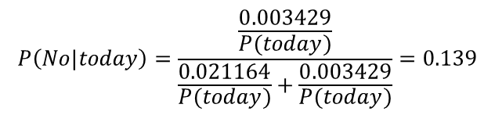
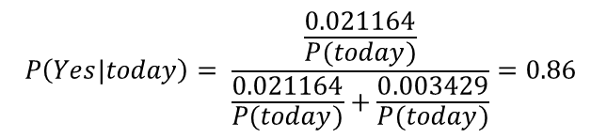



What is the probability that the match will be played if it is Sunny, Cool, Normal, and Weak.
$$P\left(Yes\right)=\frac{Number of Yes}{Total Number of Matches}= \frac{9}{14}$$
$$P\left(Sunny|Yes\right)=\frac{2}{9}$$
$$P\left(Cool|Yes\right)=\frac{3}{9}$$
$$P\left(Normal|Yes\right)=\frac{6}{9}$$
$$P\left(Weak|Yes\right)=\frac{6}{9}$$
$$P\left(No\right)=\frac{Number of No}{Total Number of Matches}= \frac{5}{14}$$
$$P\left(Sunny|No\right)=\frac{3}{5}$$
$$P\left(Cool|No\right)=\frac{1}{5}$$
$$P\left(Normal|No\right)=\frac{1}{5}$$
$$P\left(Weak|No\right)=\frac{2}{5}$$
$$P\left(Yes|today\right)=\frac{P\left(Sunny|Yes\right) P\left(Cool|Yes\right) P\left(Normal|Yes\right) P\left(Weak|Yes\right)P\left(Yes\right)}{P(today)} = \frac{\frac{2}{9} x\frac{3}{9} x\frac{6}{9} x\frac{6}{9} x \frac{9}{14}}{P(today)} =\frac{0.021164}{P(today)}$$
$$P\left(No|today\right)=\frac{P\left(Sunny|No\right) P\left(Cool|No\right) P\left(Normal|No\right) P\left(Weak|No\right)P\left(No\right)}{P(today)}=\frac{\frac{3}{5} x\frac{1}{5} x\frac{1}{5} x\frac{2}{5} x \frac{5}{14}}{P(today)}=\frac{0.003429}{P(today)}$$
$$P\left(Yes|today\right)+P\left(No|today\right)=1$$
$$P\left(Yes|today\right)= \frac{\frac{0.021164}{P(today)}}{\frac{0.021164}{P(today)}+\frac{0.003429}{P(today)}}=0.86$$
$$P\left(No|today\right)=\frac{\frac{0.003429}{P(today)}}{\frac{0.021164}{P(today)}+\frac{0.003429}{P(today)}}=0.139$$
$The term P(today) appears in both the numerator and the denominator, so it will cancel out.$ There wont be an y change in the final results.
$$Predicted Class={argmax}_{c_{i}} P(c_{i})\prod_{i=1}^{n}{P\left(Θ_{i} | c_{i}\right) }$$

